Slide 1
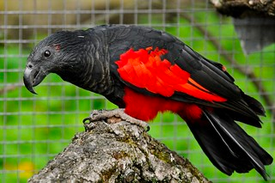
Federico Ferretti, Matteo Pasotti, Salerno Fabio
Birds signals

Slide 2
Task 1
Audio classification

Slide 3

text
Dataset: BirdCLEF 25 SPECIES
Dataset of:
25 bird species
1.700 training audio (~68 audio per species),
50 test audio (2 audio per species)

Slide 4
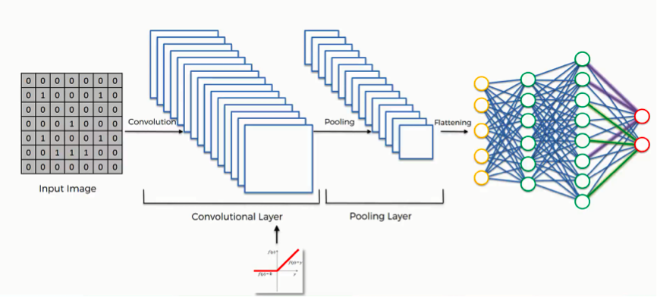
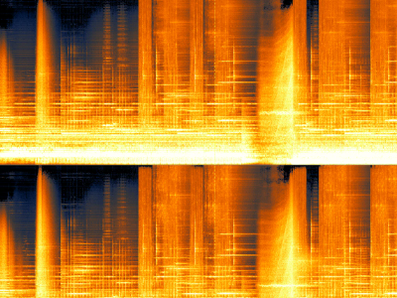

The architecture
Audio bird
Spectrogram
48 x 128
Convolutional Neural Networks

Slide 5
Convolutional Neural Network
Conv2D(16, (3, 3), activation='relu'
BatchNormalization()
MaxPooling2D((2, 2))
Conv2D(32, (3, 3), activation='relu'
BatchNormalization()
MaxPooling2D((2, 2))
Conv2D(64, (3, 3), activation='relu'
BatchNormalization()
MaxPooling2D((2, 2))
Conv2D(128, (3, 3), activation='relu'
BatchNormalization()
MaxPooling2D((2, 2))
GlobalAveragePooling2D()
Dense(128, activation='relu')
Dropout(0.5)
Dense(len(LABELS), activation='softmax')

Slide 6
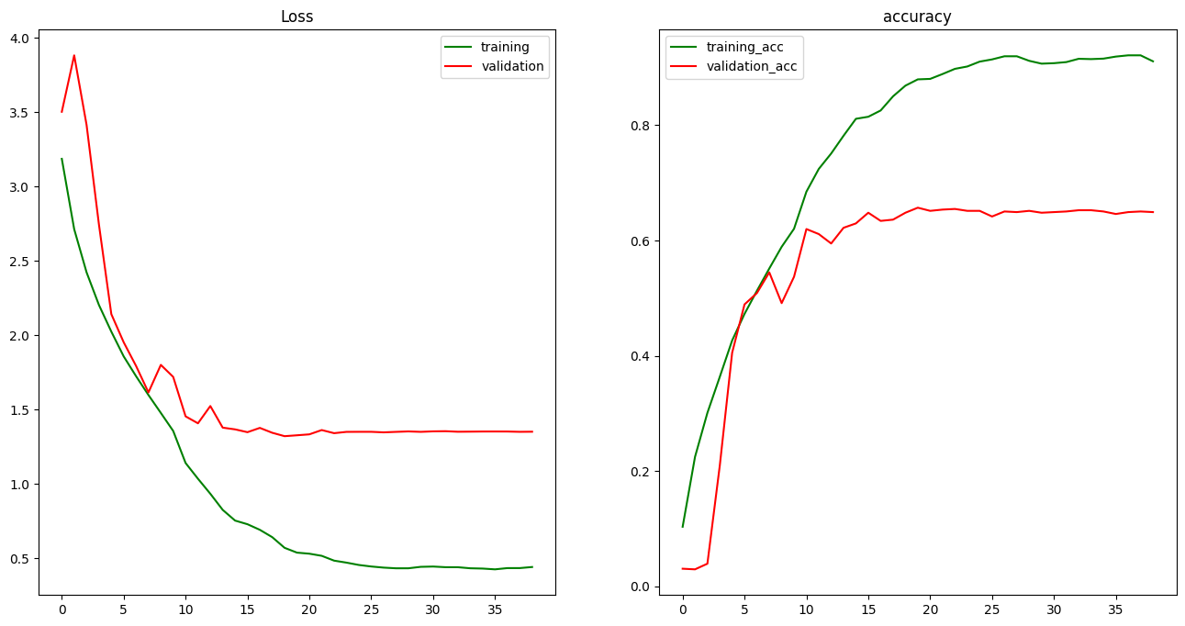
Training
Epoch 39/50 with Early stopping
loss: 0.4425 - accuracy: 0.9109 - f1_score: 0.9111
val_loss: 1.3519 - val_accuracy: 0.6492 - val_f1_score: 0.6425

Slide 7
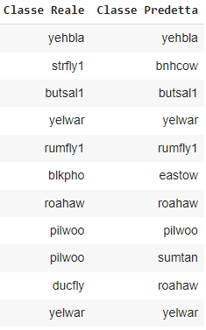
Test set performance
Overall
Accuracy: 0.60
Precision: 0.60
Recall: 0.60
F1score: 0.56

Slide 8
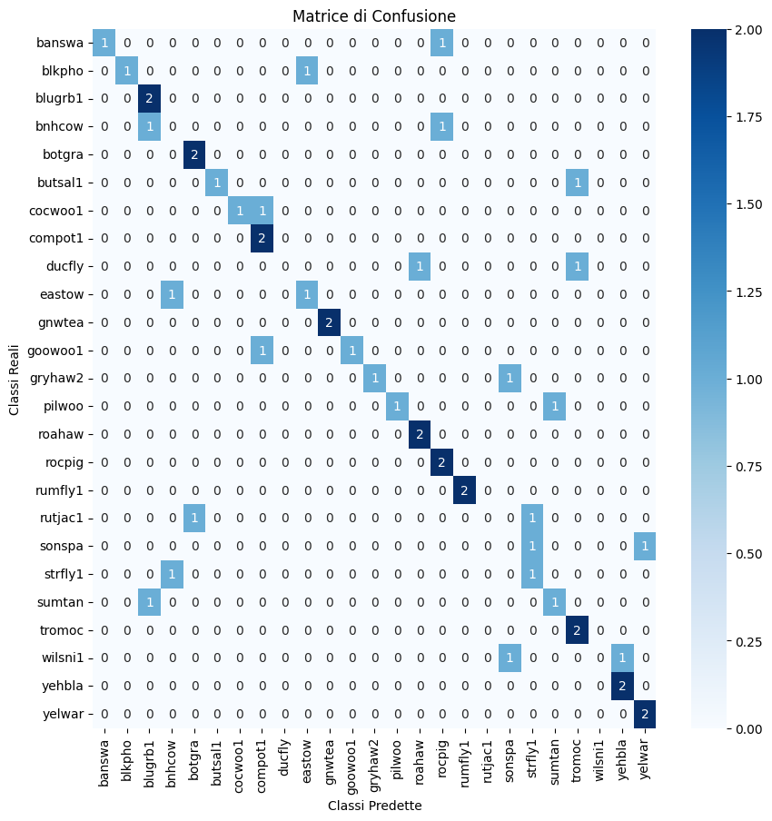
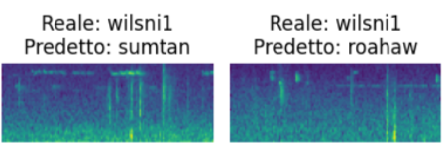
Error Analysis
Strategies to advance and refine the model's capabilities
Dataset Expansion
Post-Prediction Processing
Ensemble Learning

Slide 9
Task 2
Image classification

Slide 10
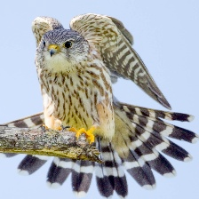
Dataset: BIRDS 525 SPECIES
Dataset of:
525 bird species
84.635 training images (~160 img per species),
2.625 test images(5 img per species) and
2.625 validation images(5 img per species).
150x150x3

Slide 11
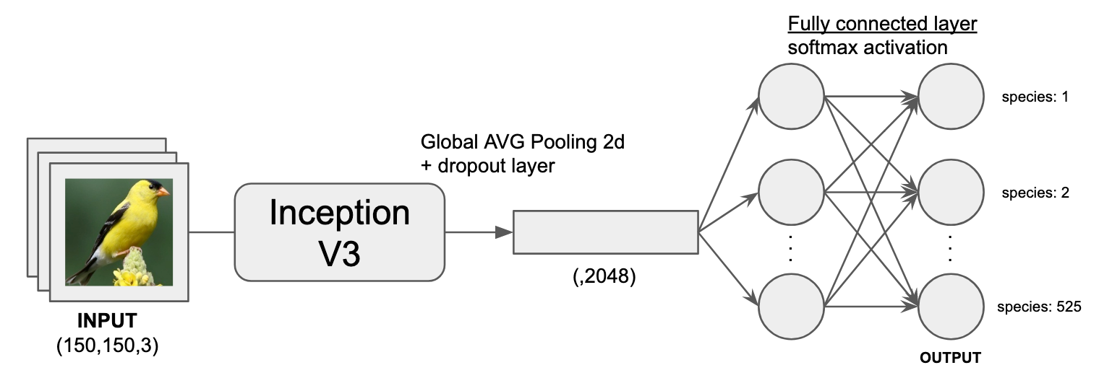
The architecture
InceptionV3
pre-processing
Data augmentation:
Horizontal Flip
Rotation Range=15
Brightness Range=[0.8, 1.2]
Notes:
Input Layer: The input dimension is indicated as (150,150,3), which suggests that the network expects images of 150x150 pixels with 3 color channels (RGB).
Inception V3 Module: This is a complex, compound layer consisting of several convolutional layers with different filter sizes and strides. The Inception architecture is known for its efficiency in terms of computational resources and was a significant advancement in the field of deep learning for computer vision tasks.
Global Average Pooling 2D: This layer is used to reduce the spatial dimensions of the feature map to a single vector. It calculates the average output of each feature map in the previous layer, thereby reducing the data significantly and preparing it for the final classification layer. This technique also helps to minimize overfitting by reducing the total number of parameters in the model.
Dropout Layer: Dropout is a regularization technique used to prevent overfitting. During training, some number of layer outputs are randomly ignored or "dropped out." This means that their contribution to the activation of downstream neurons is temporally removed on the forward pass and any weight updates are not applied to the neuron on the backward pass.
Fully Connected Layer with Softmax Activation: This is the final layer in the network. It's a dense layer with as many neurons as there are classes for the classification task (in this case, 525 species). The softmax activation function is used to generate a probability distribution over the 525 classes, with each value representing the network's confidence that the input image belongs to a particular class.

Slide 12
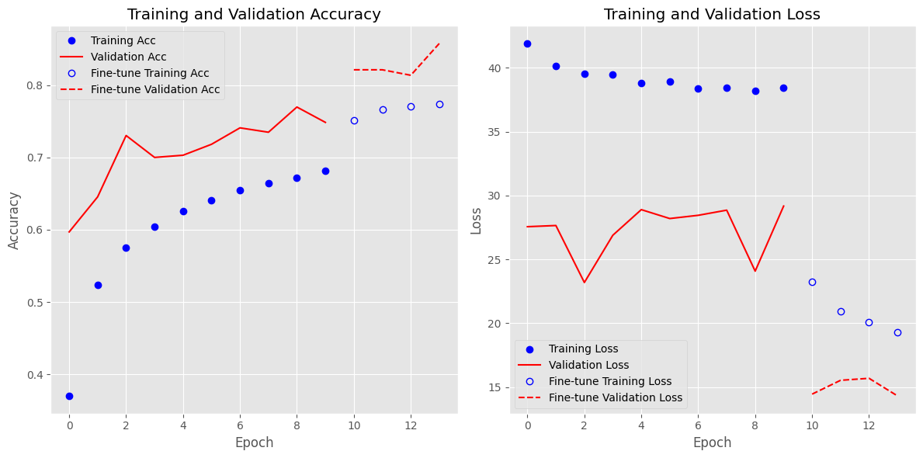
Training
10 epochs training
4 epochs fine-tuning
(last 12 layers unfreezed)
Accuracy
test (10 epochs): 76.6%
test (fine-tuning): 85.5%
8.9% improvement

Slide 13
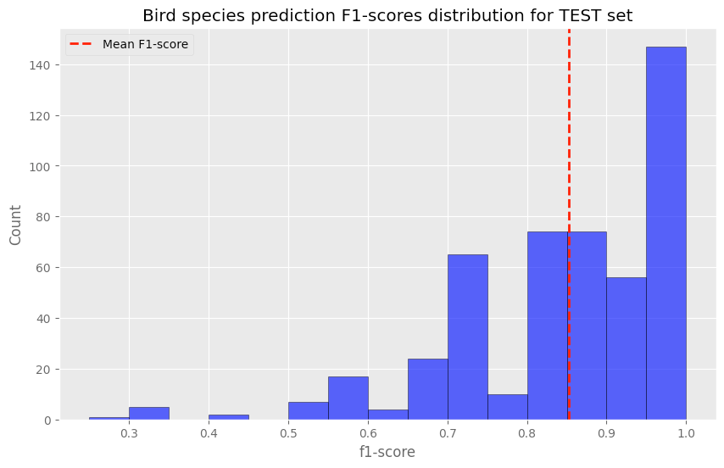
Test set performance
Overall
By species
Accuracy: 85.5%
Precision: 88%
Recall: 85.5%
F1score: 85.2%
By plotting each bird species’ F1-Score on a distribution plot, we can see that there are 165 (30.4% of total) bird species with F1-Scores smaller than 0.8.

Slide 14
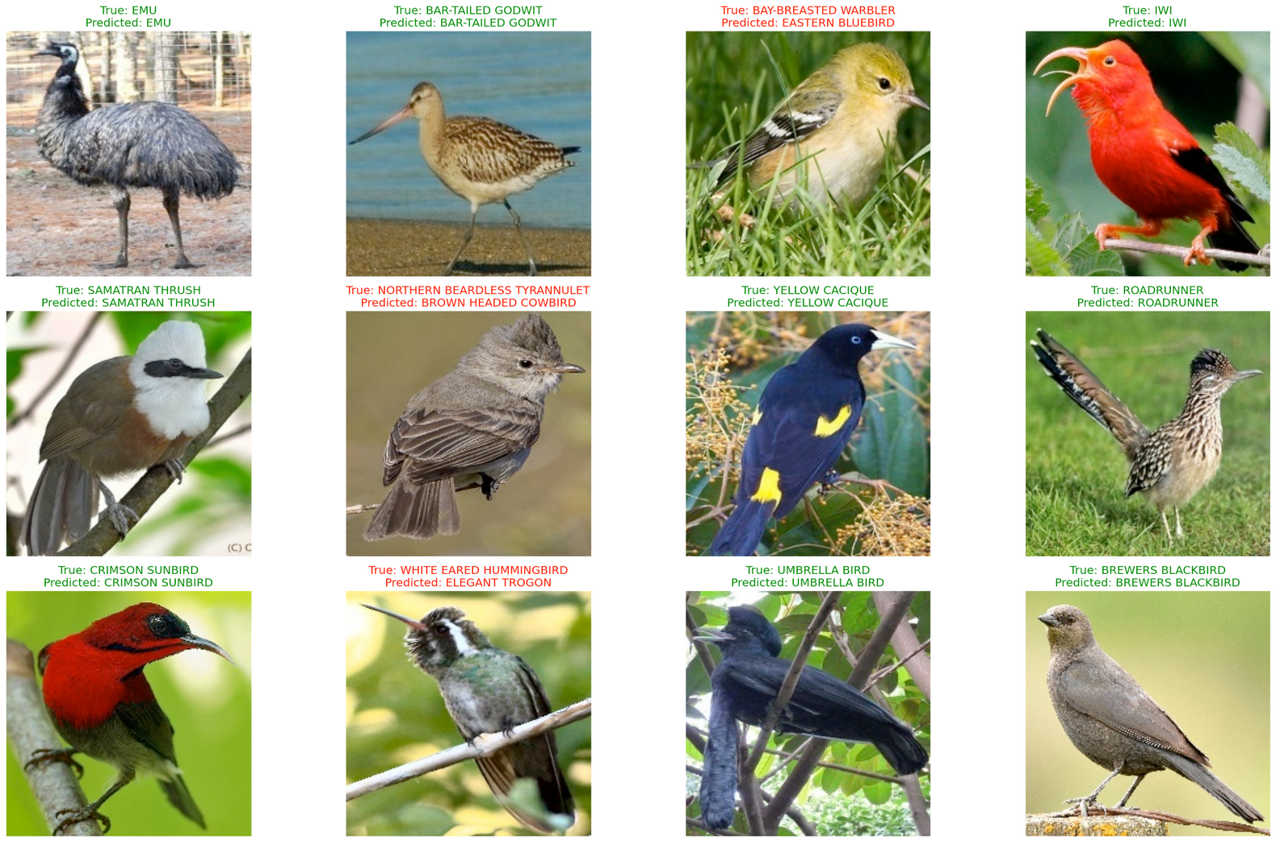
How the model makes prediction?
12 random birds classified

Slide 15
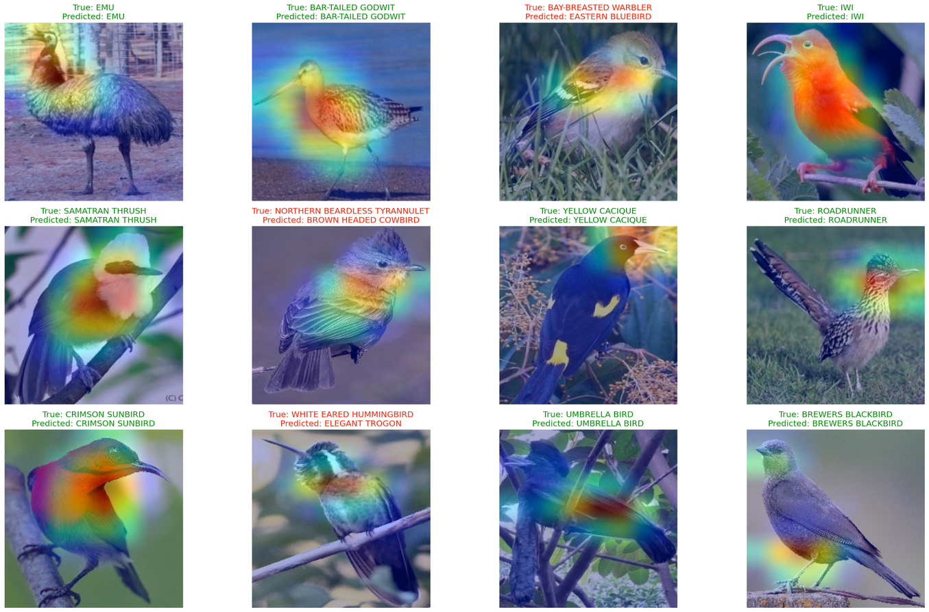

Grad-CAM
Grad-CAM viz:
In every bird image, we find the areas of the image that are important for the CNN to make its class predictions.
IWI species
(first row, forth column)
The CNN has made the correct prediction because of its red neck
BAY-BREASTED WARBLER species
(first row, third column)
The CNN focused on the wing. Why the mistake?

Slide 16
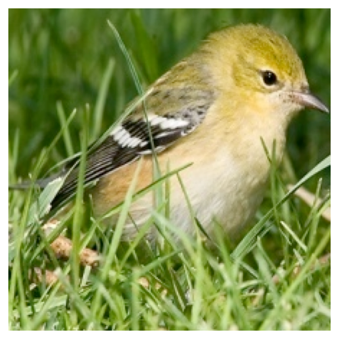
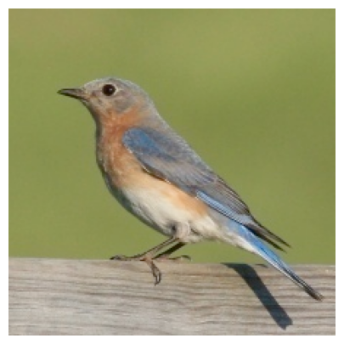
Why the mistake?
True: BAY-BREASTED WARBLER
Predicted: EASTERN BLUEBIRD
Notes:
In terms of error analysis, the CNN made an incorrect prediction for BAY-BREASTED WARLBER because it seems to have mistaken the back of its head and left body side as that of the EASTERN BLUE BIRD
Further checks in the train data highlight some a slight resemblance in the aforementioned body parts.

Slide 17
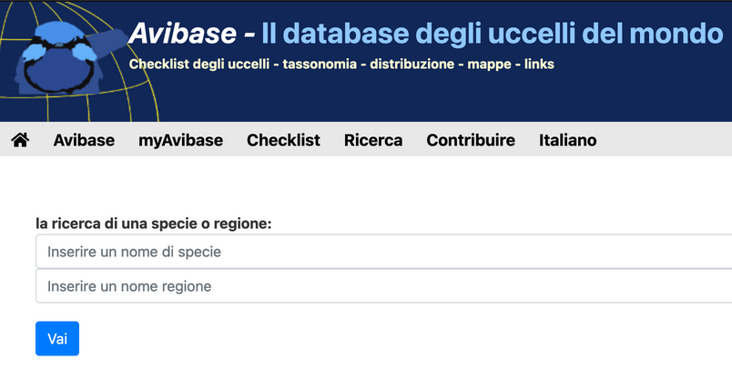
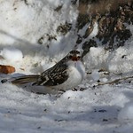
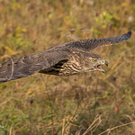
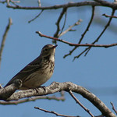
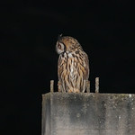
Outside the test set
50 birds images
from 17 species
Image quality:
not centered
less than 50% of the image
hostile background
Notes:
The accuracy on the handcrafted test set is 34%, while the F1score is 40.5%
The results are not so good compared to the test set, however the following considerations can be done, for better contenstualizing the result:
From the 525 species the handcrafted test set contains only 17 species, randomly selected.
The images from the kaggle dataset are perfectly centered and the bird takes most of the image space. This wasn't done with the e handcrafted test set to better evaluate the model with imperfect images and also to better evaluate how the data augmentation improved the predictions.

Slide 18
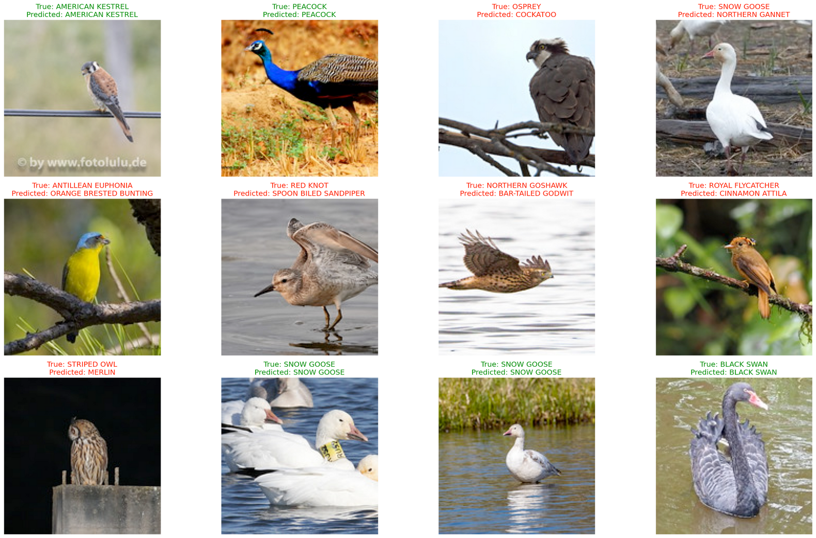
Outside the test set
12 random birds classified
Accuracy: 34%
Precision: 58%
Recall: 34%
F1score: 40%
Centered images (Black swan) or with more than one animal (Snow Goose).
Good predictions
Not centered images
(Northern Goshawk)
or distant images
(Stripped Owl)
tends to be mistaken

Slide 19
Task 3
Image retrieval

Slide 20
Dataset: BIRDS 525 SPECIES
Dataset of:
525 bird species
84.635 training images (~160 img per species),
2.625 test images(5 img per species) and
2.625 validation images(5 img per species).
299x299x3

Slide 21
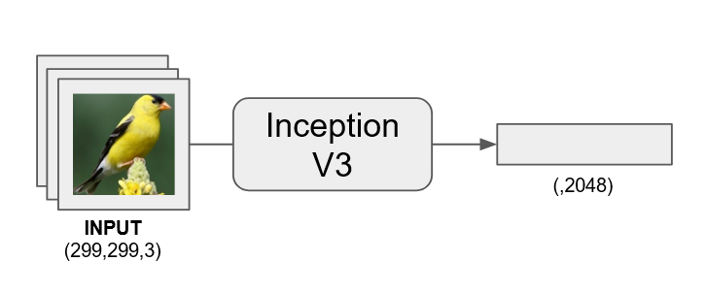
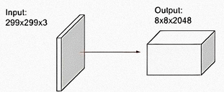
The Architecture
InceptionV3
pre-processing
No output
Layer
Only Convulation part

Slide 22
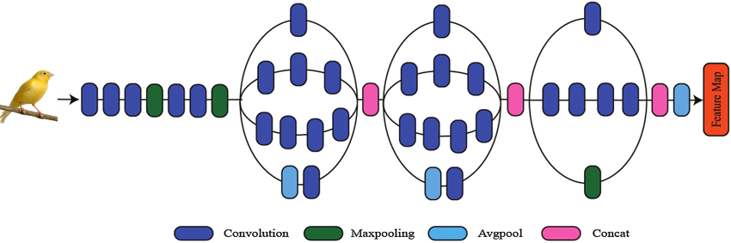
Inside the InceptionV3
Convolution
Applying filters to extract low-level features such as edges and textures.
Maxpooling
Reducing feature map sizes by retaining the maximum values within pooling windows, aiding in data dimensionality reduction.
Avgpool
Compresses feature maps by calculating the average values in pooling windows.
Concat
Merging features from different paths or layers to preserve multi-scale information.
Feature Map
Comprising high-dimensional feature maps that encapsulate the image's extracted information.

Slide 23
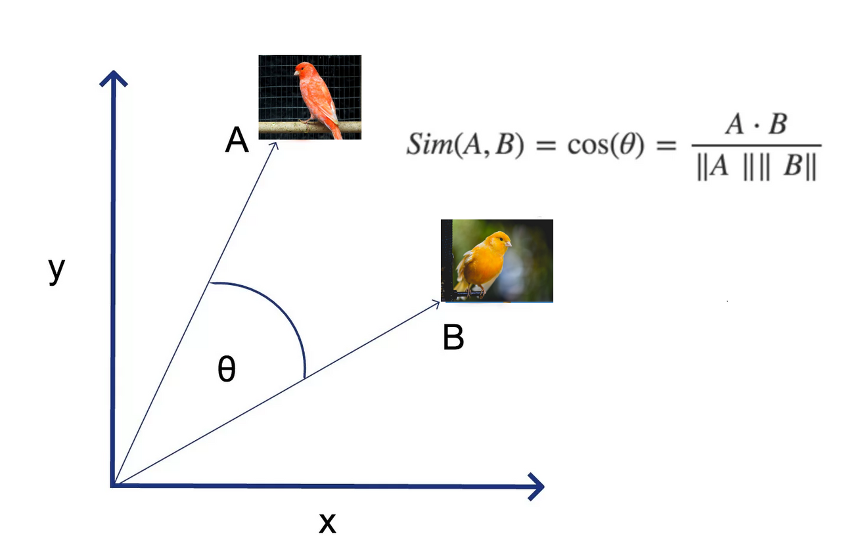
Cosine Similarity
Cosine similarity measures how similar two image feature vectors are
These vectors represent the visual contents of the images, like colors and shapes
Score ranges from -1 to 1, with 1 meaning the images are very similar.

Slide 24
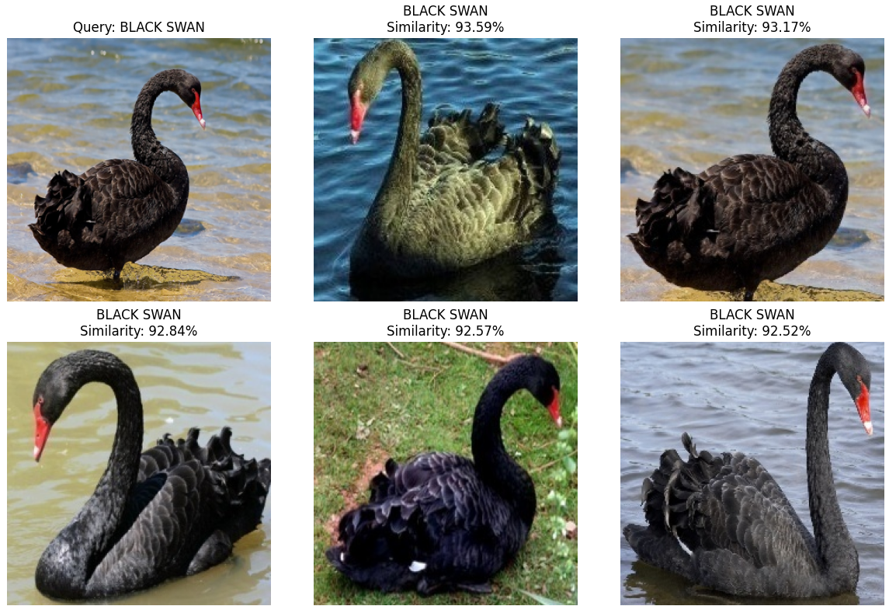
Identifying Similar Images
A query image is converted into a feature vector and compared to a dataset's vectors via cosine similarity
Images are then ranked by similarity, with top matches returned
The output is a list of the most similar images. Similarity is the in %

Slide 25
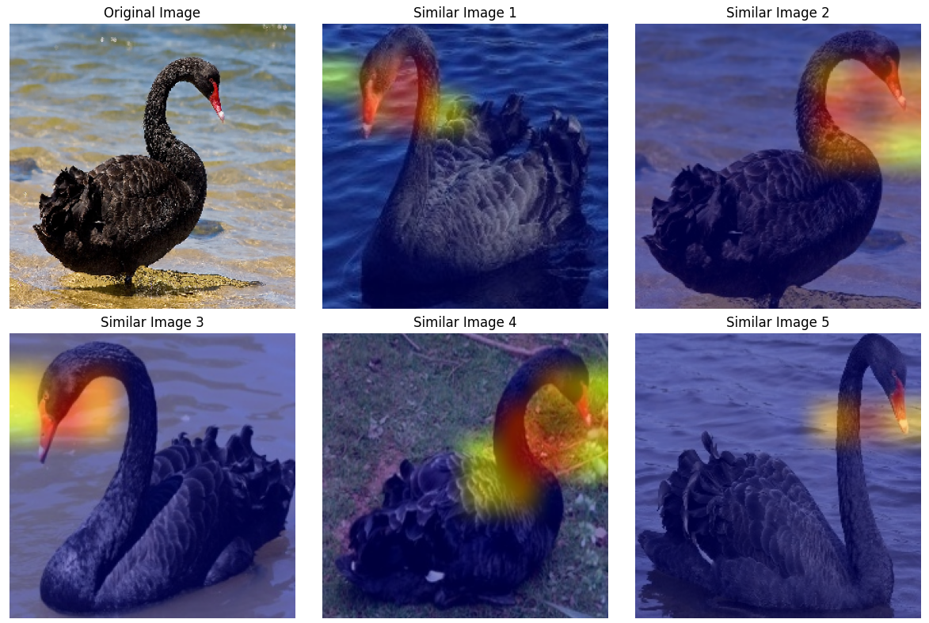
Visualizing Image Features with Grad-CAM
Show heatmaps overlaid on similar images to highlight the features that contributed most to the neural network's decision.
Each heatmap indicates areas of high importance in red to yellow gradients, with cooler colors indicating lesser importance.
The most intense areas (warmest colors) usually correspond to the
distinctive features of the swan that the model focused on when assessing similarity.

Slide 26
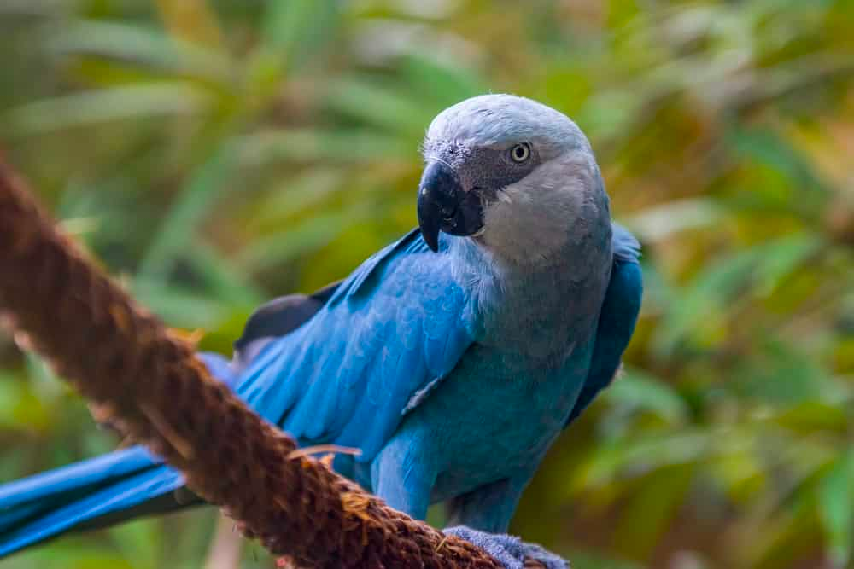
Thank you

